Slide 2
ANNUAL MEMBERSHP MEETING Monday, August 18, 2025 5:00 PM – 6:00 PM MST

Slide 3
Agenda
Welcome
Thank You Annual Partners, Conference Sponsors
Mission & Vision
State of the Union and Strategic Plan Update
Committee Reports
Financial Review
2026 Board of Directors Election
Q&A

Slide 4



Thank You to our Visionary Partner

Slide 5







Thank You to our Supporting Partners

Slide 6






Thank You Conference Sponsors
PLATINUM
SILVER

Slide 7
MISSION & VISION
MISSION
To provide leadership and advocacy to advance the healthcare internal audit profession globally by facilitating relevant education, resources, certification and networking opportunities.
VISION
To be the premier association for healthcare internal auditing.

Slide 8
State of the Union & Strategic Plan
2023-2025

Slide 9
ACCOMPLISHMENTS
Launched a new and improved AHIA membership portal in July 2025
Currently have 1,310 members
Currently have 273 CHIAPs, with a 90% renewal rate
Fourth year delivering our Annual Partnership Program
Held a very successful CAE Roundtable in Nashville

Slide 10




Strategic Objectives
To focus resources on healthcare internal audit and grow membership by 5% in 1.5 years and 10% by 2025, with a retention rate of 90%.
To complete exam preparation materials by 2025.
To develop and launch communication strategy for educational programming and evaluate progress by 2025.
To develop three strategic alliances by 2025.

Slide 11
Looking Ahead
2025 Southern California Regional
San Diego, CA - Thursday, October 2, 2025, 8:00 AM – 5:00 PM
2025 Southern California Audit Leaders Roundtable San Diego, CA - Friday, October 3, 2025, 8:00 AM – 12:00 PM
2025 AHIA Virtual Conference The Best of Denver
November 12-13, 2025
45th AHIA Annual Conference
To be announced

Slide 12
Committee Reports

Slide 13
Membership & Awards Committee
MJ Schroeder Membership & Awards Committee Chair
Sherry Tomaine Membership & Awards Committee Vice Chair
Shawn Stevison Board Liaison

Slide 14
Membership & Awards Committee
Mission: To promote the interest of prospective members in the Association of Healthcare Internal Auditors and to maintain the interest of existing members.
2024 – 2025 Activities:
Developed a "quick poll" process to engage membership throughout the year– sent out 7 quick polls to members
Membership growth – up 101 members since December 2023
Worked with Talley to support the standardization of membership renewals and streamlining of membership categories.
On Target
Closing the gap between healthcare auditors that are NOT members of AHIA
Volunteer tracking/recognition
Re-engagement campaign

Slide 15
Certification Committee
Valla Wilson` Certification Committee Chair
Larry Wallis Certification Committee Vice Chair
Nicole Phifer Candidate Application Review Subcommittee Chair
Debi Weatherford Item Writer Subcommittee Chair
Lisa Litwiller Exam Preparation (Education Task Force) Chair
Darryl Rhames Board Liaison

Slide 16
Certification Committee
CHIAP Certifications and Renewals
Approximately 280 Active CHIAP Certificants
Over 90% of the Certificants have recertified
CHIAP Exam Offerings
Approximately 280 Active CHIAP Certificants
On-line exams are offered twice a year for the past two years; committee will be evaluating on-demand options
Analysis of passing score completed and reaffirmed
Certification Committee Goals
Strategy #1 – Leverage existing resources to develop CHIAP exam prep opportunities
Hold candidate Discussion workgroups offering at least 2 meetings for each exam window
Increase Item Writer SMEs to continue to Increase the number of practice exam questions (75 questions are now available).
Continue to enhance the Body of Knowledge Road map which now provides direct links to study resources with exam prep content and “On Demand” Recordings to increase knowledge essential to healthcare internal audit professionals to prepare for the exam.
Strategy #2 Develop new study Materials
Exam preparation education task force focus initiative.

Slide 17


Certification Committee
Become a Certified Healthcare Internal Audit Professional to‎:
Prove your competency, skill and dedication to the healthcare internal auditing profession
Earn credibility and respect in your field.
Advance your career and create new professional opportunities.
Visit https://ahia.org/about-chiap-certification/
to learn more.

Slide 18
Certification Committee
Advance Your Career with the CHIAP® Certification!
AHIA’s Certification Management System is Open for Applications!
The current application is open through September 30, 2025.
The next CHIAP exam window will be open for testing from October 1 – November 30, 2025.
Now testing via Online Proctored Examinations.
Visit https://ahia.org/about-chiap-certification/
to learn more.

Slide 19
Annual Conference Committee
Hayley Oakes Conference Committee Chair
Jonathan West Board Liaison

Slide 20


Annual Conference Committee
Annual Conference Committee
44th AHIA Annual Conference: August 17-20 in Denver, Colorado.
Virtual Annual Conference: November 12-13
Thanks to the Annual Conference Committee members for going above and beyond!
NASBA CPE Review
Thanks to the CPA members who volunteered to review and attest to the Accounting/Auditing presentations
Successful planning, coordinating, and executing a successful in person Annual Conference in 2025.

Slide 21
Regionals and Roundtables Committee
Ruth Bartholomew Regionals & Roundtables Committee Co-Chair
Todd Havens Regionals & Roundtables Committee Co-Chair
Jerry Lear Board Liaison

Slide 22
Regionals and Roundtables Committee
Regional Seminars and Roundtables
The 2025 regionals & roundtables (R/RT) committee’s goal is to provide two in-person regional conferences and audit leader roundtables and one virtual seminar. This goal is on track.
Completed in-person R/RT in Nashville (sponsored by Protiviti and hosted by HCA) on May 29/30 achieving attendance goals and budgeted net revenue.
Planning in process for Southern California R/RT, which will be sponsored and hosted by Deloitte in Costa Mesa, CA on October 2/3.
Virtual IT Roundtable is committed with Eminere hosting on October 21.
Other Committee Goals
The 2025 committee had several other staffing/operating goals, which are also on track as follows:
Identify committee members local to R/RT events to assist with planning/execution of meetings. This was completed with Todd Havens in Nashville and Andrew Tinseth in SoCal. Johan Lidros and Valla Wilson are assisting with the Virtual roundtable.
Develop playbook for R/RT that outlines tasks, timelines, budgets, etc. Playbook was developed and was utilized for Nashville. As well, it is currently being utilized for the SoCal R/RT.
Formally define roles and responsibilities for committee members and staff, including Talley. This has been completed.

Slide 23
Annual Partnerships and Affiliations
Beth Schindler Partnerships and Affiliations Committee Chair
Heather Zundel Board Liaison

Slide 24
Annual Partnerships and Affiliations
Mission: Develop and support annual partnerships and affiliations with like-minded organizations in alignment with AHIA’s strategic plan.
Amazing Committee Member: Angelle Granier has been spearheading the Affiliations program
Annual Partnerships
Purpose: To collaborate with industry partners to increase benefits provided to our members
2025 Participation: 8 Partnerships, 1 Visionary and 7 Supporters
Focus: Soliciting annual partners for 2026. Partners can receive benefits year-round, such as, complimentary memberships, advertising options and annual conference packages.
Affiliations
Purpose: To expand visibility and reach of AHIA to potential new members and strengthen the internal audit profession
New Finalized Affiliation: Memorandum of Understanding has been recently executed with another association, look for more information in the coming weeks!
Prospective Affiliations: Additional organizations/associations are at various phases of discussion for potential affiliations, including the Institute of Internal Auditors

Slide 25
Marketing Committee
Vicky Gabbai Marketing Committee Chair
Alan Henton Board Liaison

Slide 26

Marketing Committee
Mission: Support AHIA by providing valuable strategic insights on how to best promote AHIA initiatives and reach defined goals.
LinkedIn:
Optimize LinkedIn posting visibility, clarity, and engagement to reach current and prospective followers & members
Annual Conference:
Planned Virtual Events for 2024 (Events Air Contests, Giveaways)
Hold social media contests, host Trivia Night, curate conference-specific posts during the event, provide Gift Card Giveaways for New Member Breakfast, Conference Raffle, Exhibitor Passport, Trivia Night, LinkedIn Engagement Contests for 2025 conference
Other Activities:
Coordinate quarterly meetings with Conference, MAC, and Certification Committees to align efforts and avoid duplication.
Maintain up-to-date AHIA materials aligned with modern design and social trends.
Increased LinkedIn visibility by adding its logo to AHIA email & PowerPoint templates
Optimize website to ensure functionality, usability & up-to date design

Slide 27
Professional Practices Committee
Michael J. Michalowicz Professional Practices Committee Chair
Heather Zundel Board Liaison

Slide 28
Professional Practices Committee
In 2025, the PPC has helped to develop the first sub-group in the Connected Community, Artificial Intelligence (AI). It is the PPC's intention to continue in the development of additional sub-groups in 2026.
The PPC continues to maintain an active role in monitoring the Connected Community to ensure posts are appropriate and comply with the Code of Conduct and Violations policy.​
The PPC partners with Protiviti in the design, execution and reporting of the annual Healthcare Internal Audit Plan Priorities Survey and New Perspectives benchmarking article.
The PPC maps the articles from New Perspectives to the Book of Knowledge (BOK) and serves as a quality control function to ensure proper categorization and audit content in the Audit Resource Center.
Developing sub-groups of thought leadership in the Connected Community
Mapping New Perspectives to the Book of Knowledge
Partnering in the annual Healthcare Internal Audit Plan Priorities Survey

Slide 29
Publications Committee
Bob Michalski Publications Committee Chair
Jen Conley New Perspectives Editor
Valerie Mattas White Papers Sub-Committee Chair
Fatimah Muhammad E-News Sub-Committee Chair
Megan DeVries Board Liaison

Slide 30
Publications Committee
White Papers
Issued White Papers 2025:
TAG “Maximizing Value: Through Rebate Management”
Targeting 2-3 white papers per year
New Perspectives
Covered hot topics such as Price Transparency, Cybersecurity, Mega Pixel, and Discharge or Transfer
Recognized by the American Society of Business Publication Editors (ASBPE.org) for the article “IT Risk Assessments – Consider updating your practices” by Isaak Lerner, CISA, CISM, CISSP.
eNews
11 Members – Members have been Annual Conference Speakers, Track Leaders, Moderators, Content Writers for the CHIAP Certification and Compliance Publications, and AHIA Board Members
Body of Knowledge for AHIA Certification is embedded within article content published six times per year.

Slide 31
Virtual Learning Committee
Sue Smoger Virtual Learning Committee Chair
Sue Smoger
Interim Webinars Sub-Committee Chair
Darrell Goolsby
Tech Talk Sub-Committee Chair
Jerod Holloway Board Liaison

Slide 32
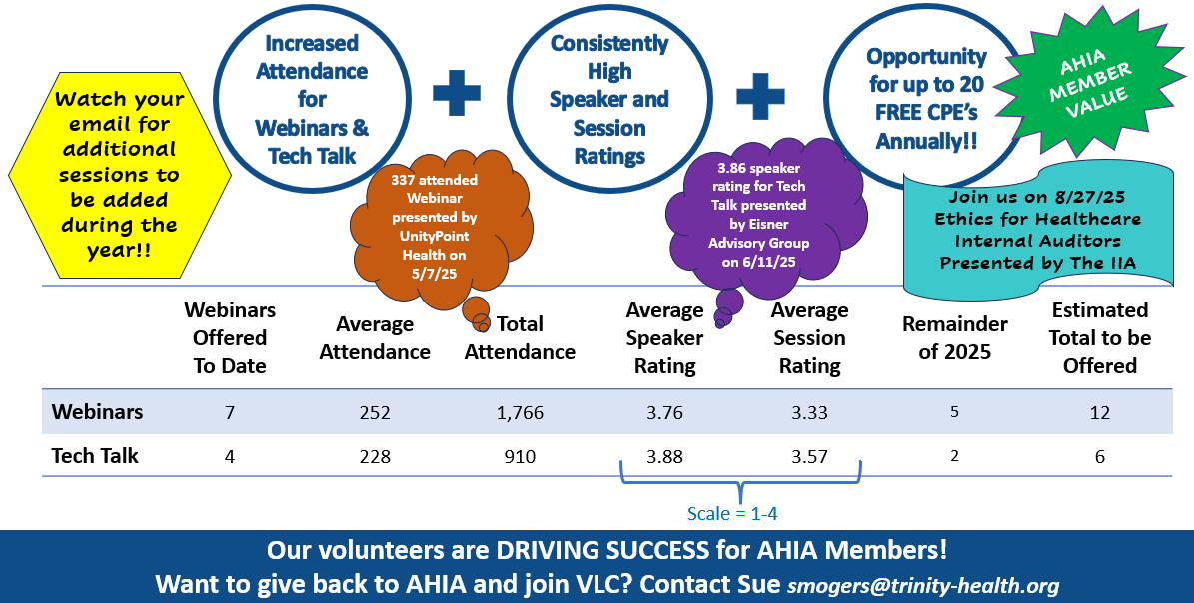
Virtual Learning Committee – 2025 Year in Review

Slide 33
Publications Committee
White Papers
Issued White Papers 2025:
TAG “Maximizing Value: Through Rebate Management”
Targeting 2-3 white papers per year
New Perspectives
Covered hot topics such as Price Transparency, Cybersecurity, Mega Pixel, and Discharge or Transfer
Recognized by the American Society of Business Publication Editors (ASBPE.org) for the article “IT Risk Assessments – Consider updating your practices” by Isaak Lerner, CISA, CISM, CISSP.
eNews
11 Members – Members have been Annual Conference Speakers, Track Leaders, Moderators, Content Writers for the CHIAP Certification and Compliance Publications, and AHIA Board Members
Body of Knowledge for AHIA Certification is embedded within article content published six times per year.

Slide 34
2025 Financial Review

Slide 35
Financial Statements
Fiscal Year: January - December
FY25 Budget FY25 YTD Financials
(Unaudited–as of June 30, 2025)
Revenue $ 975,561 Revenue $496,194*
Expense $ 934,148 Expense $418,539*
Net Income $ 41,413 Net Income $247,217
Total Net Assets: $598,129
*Includes $182,397 in annual conference revenue, a`nd $13,792 in conference expenses.

Slide 36
Financial Comparison
 | 2020 | 2021 | 2022 | 2023 | 2024 | 2025
 | Actuals (Audited) | Actuals (Audited) | Actuals (Unaudited) | Actuals (Unaudited) | Actuals (Unaudited) | Budget
Total Assets | $582,509 | $836,669 | $499,963 | $343,557 | $574,769
Total Liabilities | $141,559 | $203,368 | $199,356 | $166,128 | $226,603
Total Net Assets | $440,950 | $633,301 | $300,607 | $177,429 | $348,166
Revenue | $477,073 | $643,230 | $729,137 | $890,215 | $754,199 | $975,561
Expenses | $581,128 | $479,907 | $991,984 | $1,038,412 | $583,462 | $934,148
Net Income | ($104,055) | $163,323 | ($262,848) | ($148,197) | $170,737 | $41,413
Non-Operating Activities | $35,703 | $29,027 | ($69,526) | $27,309 | $0 | $0
Change in Net Assets | ($68,352) | $192,350 | ($332,374) | ($120,888) | $170,737 | $41,413
Total Net Assets (End of Period) | $440,950 | $633,301 | $300,607 | $177,429 | $348,166 | $389,579

Slide 37
2026 Board of Directors Election

Slide 38
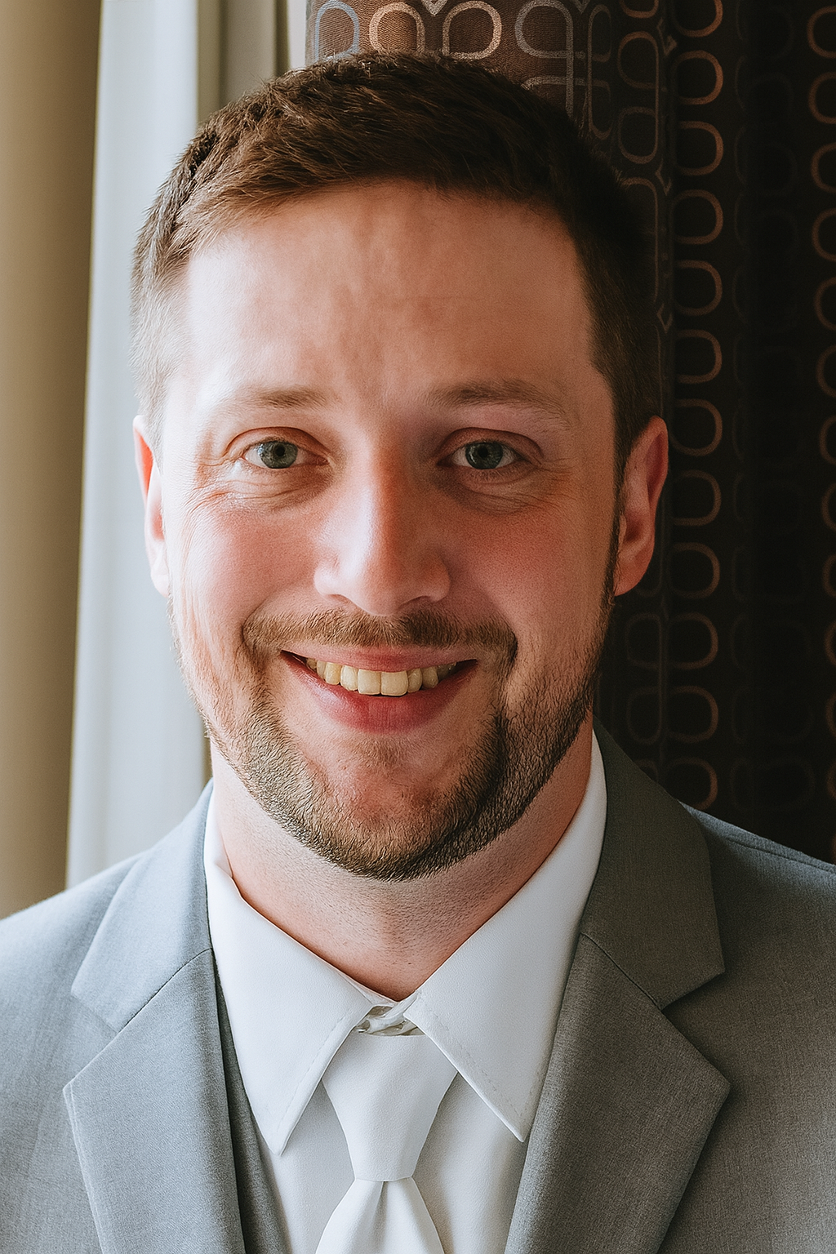
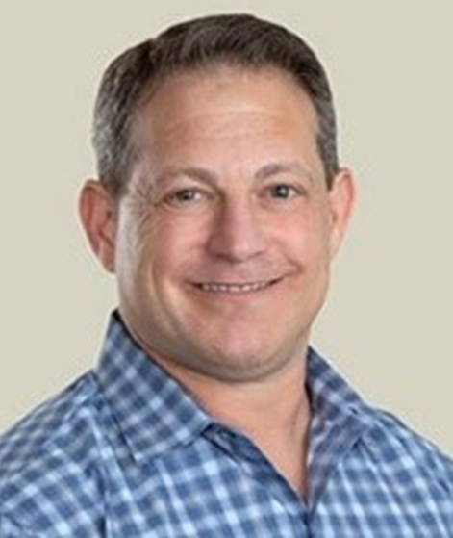
2026 Board Elections
Candidates for Secretary/Assistant Treasurer
Evan Webber, MBA, CIA, CHIAP®
Director, Internal Audit & Risk Services
OSF Healthcare
Ted Flom, CPA, CIA, CISA
Partner Armanino
Four‑year term consisting of one year each as Secretary/Assistant Treasurer, Treasurer, Vice Chair, and Chair of the Board
Vote for one
Ballot due no later than September 30!

Slide 39
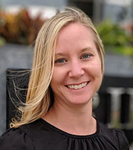
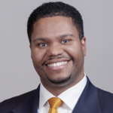
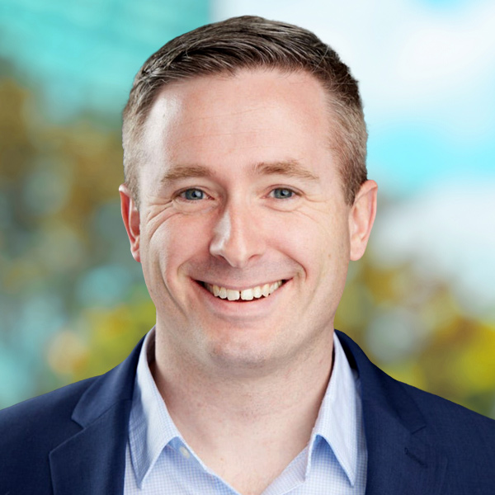
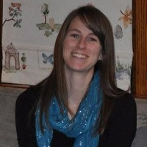
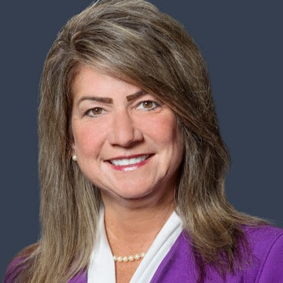
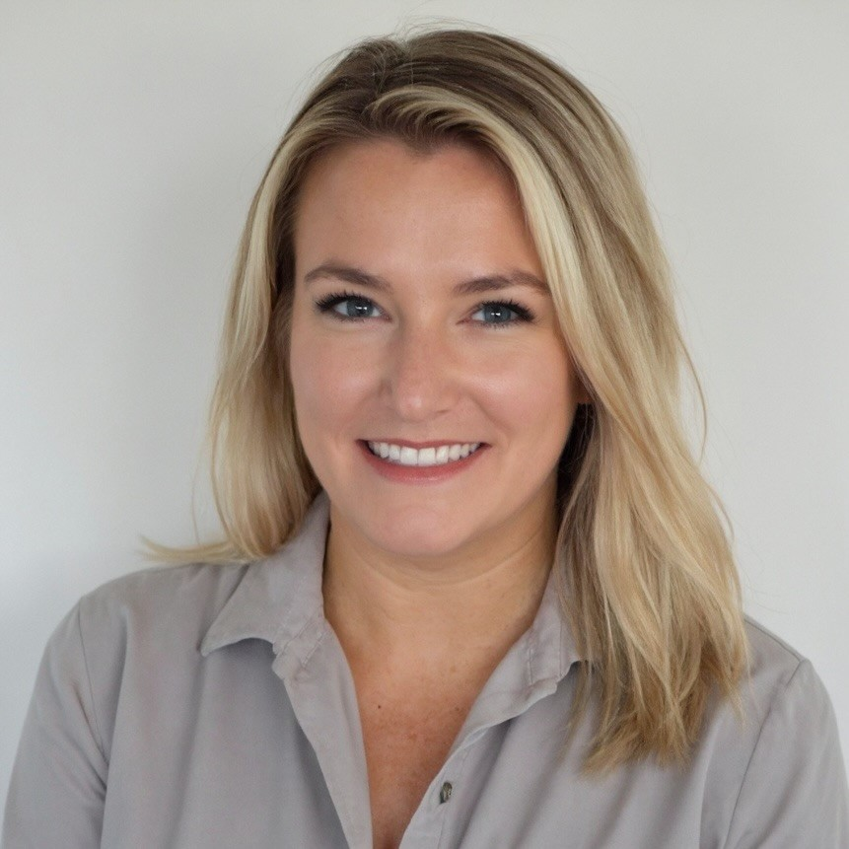
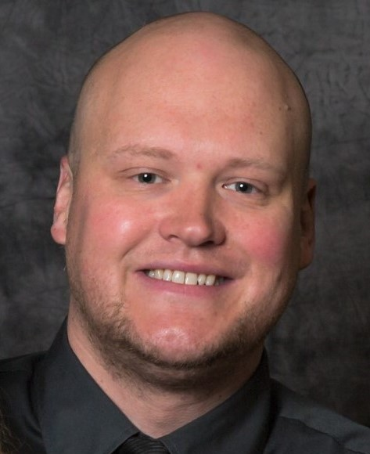
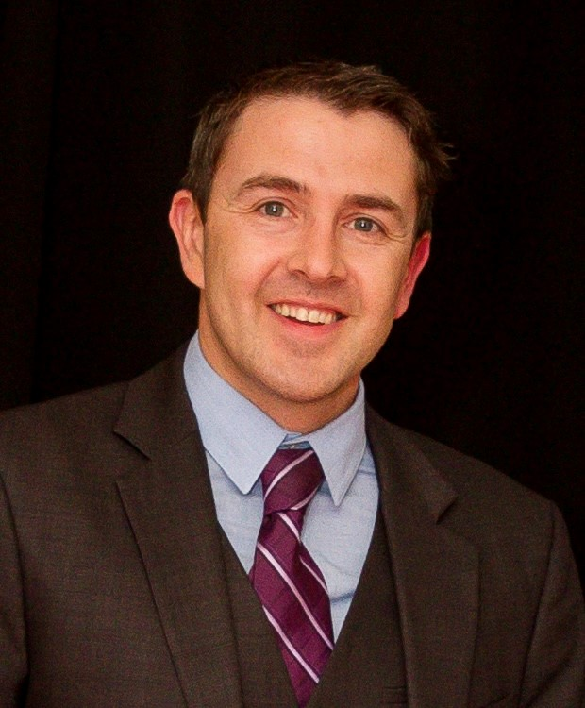
2025 Board Elections
Candidates for Board Member At Large
Megan DeVries, CIA, CHIAP® (Current Board Member) Internal Audit Manager
Corewell Health
Jerod Holloway, CHIAP®, CIA, CFE, CHC, CICA,
(Current Board Member)
Senior Director
CBIZ
Mike Witek, CIA, CFE, Emergency Medical Technician
Executive Director
Kodiak Solutions
Katie Smith, MPA, CIA, CRMA, CFE, PMP
Director, Internal Audit (IWK Health)
Govt. of Nova Scotia
Deborah Lynn Pazourek, CPA, CIA, CRMA, CHFP, CICA, CHIAP® , Lean Six Sigma
Vice President
Sarah Saunders, MSA, CPA, CIA, CHFP, CSBI
Senior Auditor
Moffitt Cancer Center
Jared Boser, MBA, CHIAP®
Lead Auditor
Community Health Network
Isaak Lerner, CISA, CISM, CISSP
Founder & Principal
Lerner Consulting
Shall each serve for a three‑year term
Vote for two
Ballot due no later than September 30!

Slide 40

2025 Board Elections Ballot
Voting Is Open!
SurveyMonkey Link:​
https://www.surveymonkey.com/r/8LNDMKP
Voting Closes on Tuesday, September 30 at 11:59 PM EST.

Slide 41

Q&A

